Slide 1
IBM Coursera Advanced Data Science Capstone Project
DILIN JOHN
08/04/2020

Slide 2
DATASET: INTRO
House Price Prediction Dataset
Describes about Sale of individual residential property in Ames, Iowa
Duration: 2006 to 2010
2930 observation
79 explanatory variables
23 nominal
23 ordinal
14 discrete
20 continuous

Slide 3
Problem statement
There are many aspects that determine house price
Enable a home buyer or a seller in knowing the market value of houses
What aspect influence the house prices the most

Slide 4
Solution
IBM Watson Studio:
https://dataplatform.cloud.ibm.com/analytics/notebooks/v2/9e941960-dc0a-45b8-aab0-e8281445fb5b/view?projectid=e4f10490-8fe9-4e0a-83a1-dae9cb365697&context=wdp

Slide 5
House price prediction: Part 2
DILIN JOHN
08/04/2020

Slide 6


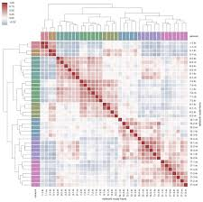

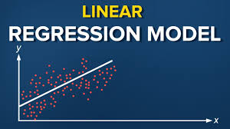
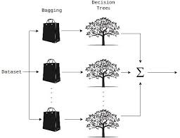


Architectural Choices
Development environment
EDA
seaborn
Model algorithms
Random Forest

Slide 7
Explanatory Data Analysis
Data import
Look for missing values
Drop features that have more than 75% missing values
Correlation test
Identify correlation features
Identify features that are strongly related to target variable: SalesPrice

Slide 8
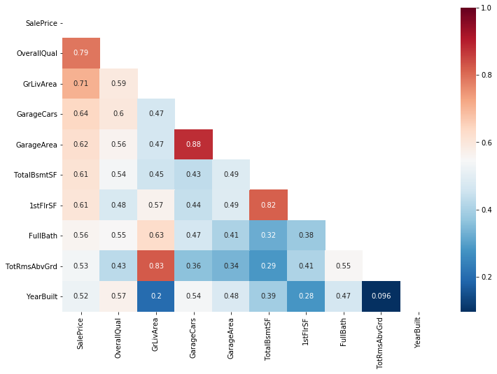
Correlation with ‘SalePrice’

Slide 9
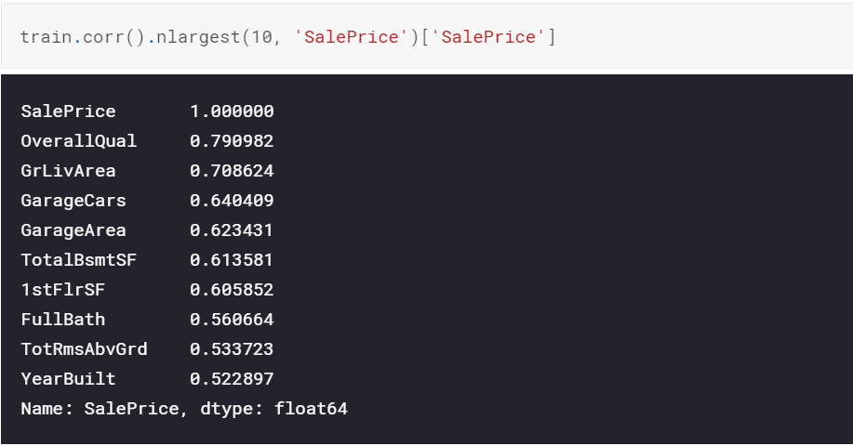
Top 10 features

Slide 10
Data processing
Identify categorical and numerical features
Impute missing values:
Categorical features: mode
Numerical features: mean

Slide 11
Outlier treatment
Examine the outliers in the shortlisted features
OverallQual
GrLivArea,
GarageCars
TotalBsmtSF
FullBath
Drop outliers as this can impact model performance

Slide 12
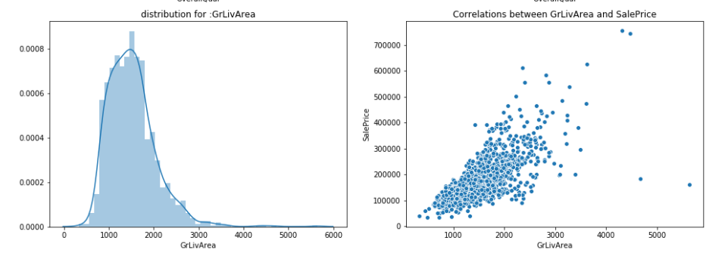
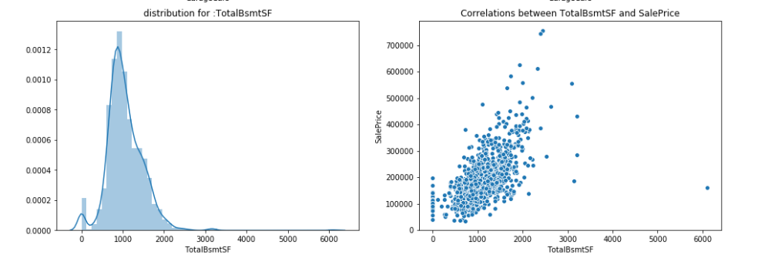
Outlier treatment

Slide 13
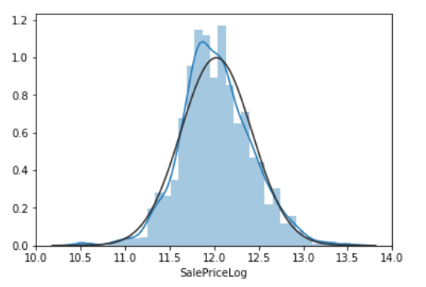
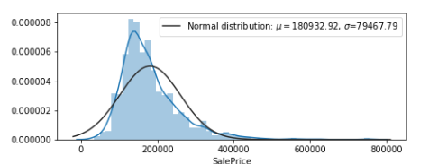
Target variable distribution
Findings:
‘SalePrice’ did not have a standard normal distribution
Positively ‘skewed’
Applied log transformation to normalize the distribution

Slide 14
Model evaluation
Metric Choice:
RMSE – Root Mean Squared error
Model evaluation:
Stratified K-fold cross validation across fold

Slide 15

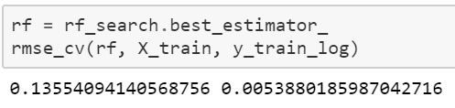
Model comparisons:
Linear Regression model
Random Forest Regressor

Slide 16
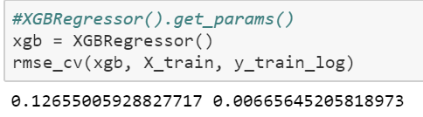
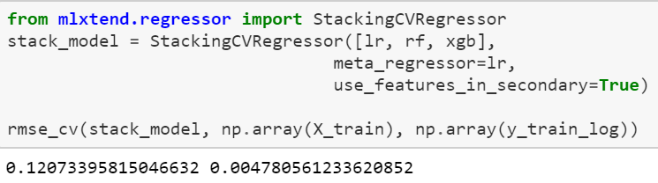
Model comparisons:
XGBoost Regression model
Stacked Regressor

Slide 17
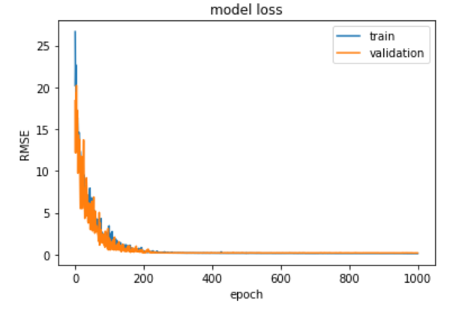
Model comparisons:
Neural Network model

Slide 18
Summary
Best model:
Stacked regression model
Lowest mean RMSE across folds
Deep learning model had the lowest RMSE error in train
As model tend to get complex, they tend to over fit and their prediction accuracy falls

Slide 19
THANK YOU

